Slide 1

IBM Churn Analysis
Dashboard Design
Capstone Project: End-to-End Analytics & Customer Retention UX
PREDICTIVE MODELING | DATA VISUALIZATION | COHORT ANALYSIS

Slide 2

Project Aim & Core Analysis
Core Pillars of Analysis
Main Objective
Financial Attrition Profile: Evaluating Month-to-Month contracts versus Annual commitments against overall monthly spend.
Develop an interactive, executive-ready dashboard to visualize Telco churn drivers and flag at-risk subscribers in near real-time.
Product & Technical Gaps: Correlating high fiber optic user churn to potential service satisfaction outliers.
By transforming raw demographic, billing, and system metrics into predictive customer intelligence, the retention team can proactively initiate saving outreach.
Loyalty Lifespans: Identifying first-year "inflection intervals" where subscriber churn rates spike heavily.

Slide 3
Dataset Metadata Overview
Variable Name | Type | Analytical Purpose & Relevance
CustomerID | Alphanumeric | Unique index to query, isolate, and route individual accounts to retention teams.
Tenure | Numerical | Represents subscriber loyalty months; heavily correlated with core brand stickiness.
Contract Type | Categorical | Segment commitment term (Monthly vs 1/2 Yr); key leverage point for contract migration.
Monthly Charges | Float / Price | Absolute billing cost metric; helps establish high-value customer churn thresholds.
Internet Service | Categorical | Broadband type indicators (DSL, Fiber, None) linked to product-level churn anomalies.
Churn (Target) | Binary (Y/N) | Historical ground truth label used to train predictive models and compute baseline attrition.
*Dataset: IBM Telco Customer Data (7,043 cohorts tracked across 21 multi-dimensional features).

Slide 4
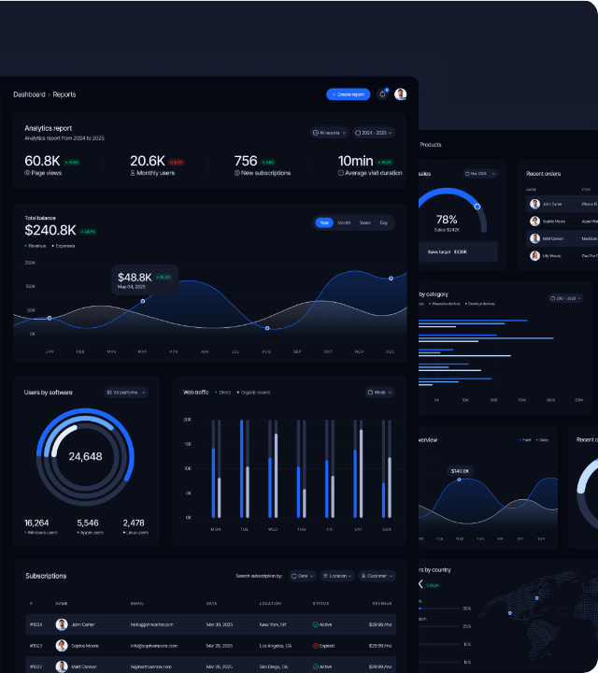
Dashboard Layout
Target UI/UX Architecture
The interface divides business intelligence and model feedback into three structured viewzones:
Primary KPIs: Overall Churn Rate, High-Risk ARR, and Segment distribution.
Operational Slicers: Dynamic filters tracking Contract, Payment method, and Support tiers.
Watchlist Table: Generates real-time, prioritize save-alerts of high-risk accounts.

Slide 5


Target Business Outcomes
15%
$2.4M
>85%
Churn Target Drop
Saved Revenue
Model Precision
By using targeted save strategies based on immediate dashboard risk triggers.
Expected ARR retained by focusing specifically on at-risk Fiber users.
Accurately mapping and flagging subscriber risk thresholds directly in UI.
Capstone Core Deliverable: A production-grade reporting interface connecting backend predictions to frontline retention success.

